Slide 1
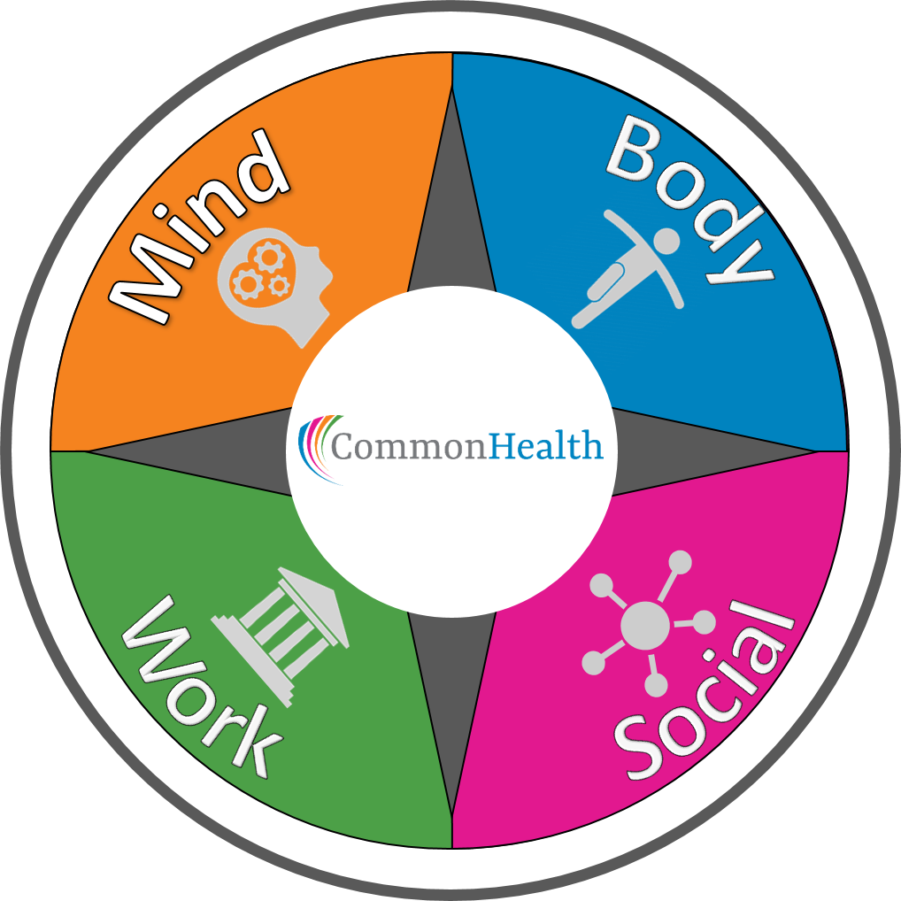
Virginia’s Employee Wellness Program
Department of Human Resource Management
Office of Health Benefits
Notes:
Welcome to the CommonHealth Agency Coordinator Training and thank you for your interest in making the CommonHealth Wellness Program available to all of the employees of your agency. We appreciate your time and commitment.

Slide 2
Training Goal
Provide the tools and resources needed to build and sustain an engaging and successful CommonHealth program at your agency.
Together, we will work to make Virginia’s workforce the healthiest in the nation!
Notes:
The goal of this training program is to give you tools and resources to help you to provide the CommonHealth Wellness benefit in a way that it is not only successful but also engaging for employees. For many years CommonHealth has been helping employees to live healthier . With your assistance, we can reach the Commonwealth’s goal for Virginia’s employees to be the healthiest in the nation.

Slide 3
CommonHealth’s Mission
Improve the health of state employees by:
Integrating wellness into the workplace culture
Providing an environment that promotes and supports changes in health behavior
Building trustworthy partnerships between employer, employee, and our wellness partners
Notes:
To achieve that goal we work together, with agency administrators and wellness partners to create an environment that promotes and supports employees’ efforts to make healthier lifestyle choices. By volunteering to coordinate the CommonHealth Program at your agency you are bringing us closer to realizing these goals. Thank you!
Now, let’s get down to some of the details that will help you succeed in your new role.
.

Slide 4
Why Wellness?
COVID-19 has presented seemingly insurmountable health, life, and business challenges.
Even before the pandemic, 6 out of 10 Americans were living with a chronic condition, and 4 out of 10 with two or more. The world discovered the very same chronic conditions put people at extraordinary risk for complications with COVID-19.
It’s time to prioritize our employees’ wellbeing.
Notes:
Wellness programs are more popular than ever. They started out as perks for large companies and used to be called corporate fitness programs. Wellness programs are now regularly part of most employee benefits package and if you think about it, worksites have become (sort of) chronic disease prevention centers.
Worksites are doing more to prevent, arrest, and even reverse lifestyle diseases than any other group. Hospitals are great at treating disease and they are good at early detection of disease, but they don’t do much in the way of prevention. The total reach and impact of worksite wellness programs dwarfs all other efforts to improve the health of adults. . And they do all this because employers enjoy the benefits that come from having a healthier workforce.
Evidence Shows the Benefits of Wellness
Think of the different benefits employers typically offer - retirement plans, healthcare, paid time off, or maternity leave. These are designed to help recruit and retain the best employees. Yet there are no published studies that show that these benefits have a measurable effect on the ability to recruit or retain workers. We do them because we believe they are important. These things are actually very hard to study and we sense that they make a difference in our ability to attract good workers. But, there is no science to back this up.
However, unlike other employee benefits, wellness programs have been studied for decades. There are hundreds of rigorous scientific evaluations of the impact of wellness programs and we have an enormous amount of very solid data that show the benefits of having a wellness program. Such as;
1) Wellness Programs Improve Employee Health Behaviors. Wellness programs are good at helping people adopt and maintain healthy behaviors. This is perhaps the biggest benefit of having a wellness program. Healthy behaviors lead to lower health risks, and lower health risks lead to less chronic disease,and, with less chronic disease employees and employers have fewer health care costs.

Slide 5
Wellness Benefits
Benefits to Individuals | Benefits to Agency
Improved health status | Improved employee health behavior
Reduced risk of chronic conditions | Reduced elevated health risk
Reduced stress | Reduced health care cost
Support to sustain healthier behavior | Improved productivity
Improved engagement and camaraderie | Decreased absenteeism/presenteeism
Low cost to participate | Improved recruitment and retention
Expert instruction | Build and sustain employee morale
Convenience | Increased engagement
Notes:
Wellness programs are more popular than ever. They started out as perks for large companies and used to be called corporate fitness programs. Wellness programs are now regularly part of most employee benefits package and if you think about it, worksites have become (sort of) chronic disease prevention centers.
Worksites are doing more to prevent, arrest, and even reverse lifestyle diseases than any other group. Hospitals are great at treating disease and they are good at early detection of disease, but they don’t do much in the way of prevention. The total reach and impact of worksite wellness programs dwarfs all other efforts to improve the health of adults. . And they do all this because employers enjoy the benefits that come from having a healthier workforce.
Evidence Shows the Benefits of Wellness
Think of the different benefits employers typically offer - retirement plans, healthcare, paid time off, or maternity leave. These are designed to help recruit and retain the best employees. Yet there are no published studies that show that these benefits have a measurable effect on the ability to recruit or retain workers. We do them because we believe they are important. These things are actually very hard to study and we sense that they make a difference in our ability to attract good workers. But, there is no science to back this up.
However, unlike other employee benefits, wellness programs have been studied for decades. There are hundreds of rigorous scientific evaluations of the impact of wellness programs and we have an enormous amount of very solid data that show the benefits of having a wellness program. Such as;
Wellness Programs Improve Employee Health Behaviors. Wellness programs are good at helping people adopt and maintain healthy behaviors. This is perhaps the biggest benefit of having a wellness program. Healthy behaviors lead to lower health risks, and lower health risks lead to less chronic disease,and, with less chronic disease employees and employers have fewer health care costs.

Slide 6
Why CommonHealth Works
Trustworthy partnerships
Diverse team of health experts
Targeted approach - in person, virtual or hybrid
Flexible to meet agency needs
Regional support
Tailored communication
Varied techniques to reach employees
Updated incentive program - MotiVAte
We are state employees too!

Slide 7
Who Can Participate?
All state employees at participating agencies, including wage, hourly, and part-time workers
Covered dependents* (over the age of 18)
Retirees and their covered dependents*
*does not include MotiVAte incentive program
Notes:
One of the first questions you will be asked is… Who can participate?
Unlike some employee benefits, ALL active employees may participate in the CommonHealth program. This includes full time, part time, wage, hourly, adjunct, and seasonal employees. Anyone who receives a paycheck from the state may participate!
In addition, any employee’s dependent 18 years or older, and covered by one of the states health benefit plans may also participate. If fact, we encourage participation by family members– the added support from family members is very important as individuals make changes to live a healthier lifestyle.
Finally, we invite our state retirees and their covered dependents to join in CommonHealth activities and programs through their former agencies.

Slide 8
So What Does CommonHealth Do?
Create and deliver health education programs & periodic wellness challenges
Empower employees to make/maintain positive lifestyle changes
Share informative weekly messages a.k.a. Wellnotes
Offer a modern incentive program called MotiVAte
Recognize employee achievements in health and wellness
Raise awareness of health and wellness benefits that are available
Serve as a liaison to connect agencies with similar interests
Notes:
Most importantly, we work with you to deliver health and wellness programs directly to your employees. Pre-covid that was usually done in person.
MotiVAte -
We also offer challenges where participants work independently to achieve certain goals - for example challenges can involve physical activity, better sleep, healthy eating etc.
Once each week we communicate health information through our emails called Weekly Wellnote. These are short communications and include 1 minute videos, healthy recipes and helpful, healthful tips on exercise, diet, stress and sleep..
We also strive to recognize employee achievement through our Wellness Champions program (SUe will tell more on this later.)
FInally, we work to increase awareness of the variety of wellness benefits available to employees who are enrolled in health plans, This include ways to access mental health benefits through the EAP and ways to save money.

Slide 9
Getting Started
Gather Support - key to success
Agency Head
HR Director
Benefits Administrator
Managers and supervisors
When we replaces I, Illness becomes Wellness
Notes:
So, you may be wondering……how do I get started?
Over the years we have found that the biggest key to having a successful and active CommonHealth Program is to have support from those at the top. So one of your first steps is to be sure that your agency administrators, human resources office,managers and supervisors are on board. If they understand that CommonHealth will benefit employees and, as a result, benefit the agency, they will be happy to lend their support.
As you ask for support, be sure that management understands that participation rarely interferes with the normal work day. Programs are usually offered at lunch time and during staff meetings and other events. And, CommonHealth has the ability to tailor programs to meet specific agency needs. With their support your efforts will go a long way. The best way for management to support CommonHealth is to let employees see them participating and encouraging others to participate.

Slide 10
Advisory Committees/Teams
Ask administrators and supervisors for assistance
Cross-agency representation
Benefits, safety, medical, training, communications, IT, front line workers, employee health enthusiast
Voluntary
Meet regularly
Outline duties
3-8 members
Notes:
In addition, many agency coordinators find it helpful to have an advisory committee to help share the load. Advisory committees are not required, but are helpful. They are particularly helpful in larger agencies or those with multiple sites ( like health districts, colleges and universities, VDOT residencies etc.). Among other things, advisory committee members can assist with program promotion, scheduling, reserving space. When setting up a committee look for VOLUNTEERS who are enthusiastic and helpful. You also want a committee with diverse skills and to have representatives from various departments and/or locations. The size of the committee would depend on the size of the agency but in general should be between 3 ( smaller agencies) and 8 (larger agencies). If you have a very small agency an advisory committee may not be necessary.
Your regional Wellness Consultant will assist you in providing a “job description” for advisory committee members - this helps ensure that your committee members are truly helpful.

Slide 11
The Nuts and Bolts
Schedule multiple health education campaigns with your Wellness Consultant each year
Promote each campaign/activity – get the word out to all employees
Coordinate wellness activities (eg. challenges)
Distribute communication materials, including weekly wellnotes to all employees
Attend meetings when scheduled
Attend trainings when offered
Notes:
After building a strong foundation of management support you are ready to roll! Next, we will cover the “nuts and bolts” of your responsibilities as an agency CommonHealth coordinator.
Our goal is to make providing CommonHealth straightforward and as simple as possible for you, the coordinators. As we review the responsibilities, please keep in mind that CommonHealth remains flexible to be able to meet each agency’s needs.
As the coordinator, your core responsibility is to schedule the CH educational programs and challenges with your Regional Wellness Consultant - ideally at least two times per year..
We will help you promote the programs with materials like flyers, email messages and anything else you need to get the word out to increase participation.
In addition to planning programs, we ask you to distribute our email communications to all employees at your location. This includes our weekly wellnotes and other special communications as they arise (not frequent).

Slide 12
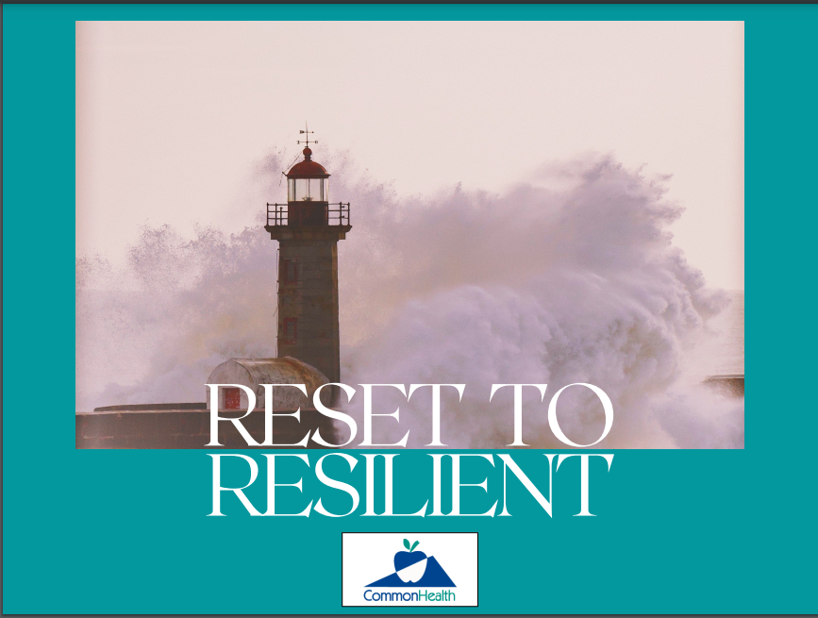
Health Education Campaigns
Better Nights
Ahead
A “how-to” guide to
better sleep.
Wise Eyes
A Guide to Healthy
Vision
Reset to Resilient
Positive Steps during Uncertain Times
Relearn to Relax
Meditation and Mindfulness for busy beginners.
Notes:
As I just mentioned, as an agency coordinator one of your most significant contributions will be to work with the CommonHealth staff to schedule 2 health campaigns at your agency each year. These campaigns are created by the CommonHealth staff and new topics are introduced on a regular schedule. This slide shows ust a few of our recent program topics.
In addition to CommonHealth’s campaign menu, your regional Coordinator may be available to assist in providing information on topics of specific interest to your agency.

Slide 13
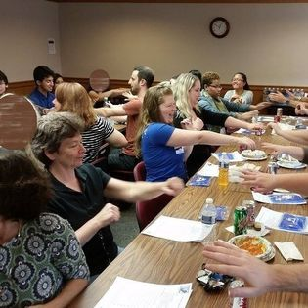
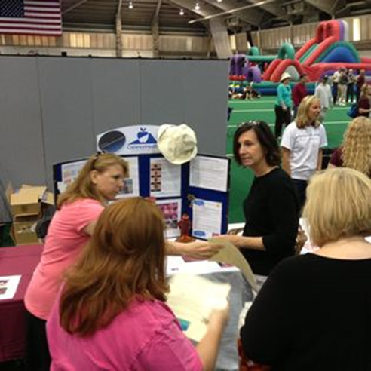
Strategies that Drive Participation
While every agency is unique, many locations have found success coordinating CommonHealth programs as a part of:
Staff meetings/picnics
Employee appreciation/recognition events
Orientation/training days
Lunch and Learn sessions
State-wide conferences
Notes:
Staff meetings and special events are a perfect time to offer the CommonHealth program to your employees - It’s efficient and usually everyone can participate easily. Simply invite your Regional Coordinator to attend your meeting and you can determine how long their presentation should last. CommonHealth is flexible and want to meet your agencies needs as best we can.

Slide 14
Options to meet your needs
Traditional Training – an onsite session that gives participants a deeper dive into educational materials facilitated by the Wellness Consultant (time frame of 15 to 60 + minutes)
Learning Station – an educational display located in a high traffic area where participants drop by to receive information from the Wellness Consultant in a more personal and relaxed format
Virtual – online sessions can be hosted by the agency on a variety of platforms
Contact your Wellness Consultant to schedule
Notes:
We understand that no 2 agencies are exactly alike, and one size doesn’t always fit all. For this reason, programs may be delivered in a variety of formats to meet your needs. Based on your what will work best for your agency, you can select the program delivery methods. Just schedule with your regional Wellness Consultant.
Traditional presentations can be delivered in 15 to 45 minutes. These may include powerpoint presentations, group activities and discussion.
Learning Stations are visual displays set in high traffic areas like lobbies, break rooms or cafeterias. Your regional coordinator will provide quick tips and information to interested employees as they stop byt the display. Learning stations work well during special events like employee appreciation luncheons, benefits Fairs and health screenings.
All CommonHealth programs are available virtually as well.
We hope with the variety of program formats, you will find it easy to schedule CommonHealth activities..

Slide 15
Communications
Wellnotes
Information on a variety of health topics delivered via email weekly.
Social Media
Find us on Facebook, Instagram and Twitter. We post tips and share information regularly. We like to feature agencies as often as possible.
YouTube
Micro learning (3-5 minute) videos on a variety of topics. Be sure to SUBSCRIBE to our channel.
Website
Materials and resources: www.commonhealth.virginia.gov

Slide 16
Wellness Champions
Notes:
We want to celebrate those who live well and inspire others to do the same. Each year, we select the best of the best and name them as our “Wellness Champions.” While nominations can be made year round, the process is promoted in May, National Employee Health and Fitness Month. When it wraps up, the applications are reviewed and considered by the CommonHealth team. Up to five employees are selected each year and their stories are highlighted in CommonHealth publications. Individuals selected for the award receive a gift bag from CommonHealth for serving as an inspirational role model and a framed certificate signed by the Governor of Virginia.
Any state employee can submit a nomination of another state employee. Spread the word and recognize the good!

Slide 17
The bottom line _______________
Agency Coordinator (AC) will:
CH Wellness Consultant will:
Propose ideal dates/times to schedule a presentation
Reserve a space
Get the word out to your co-workers
Distribute materials
Encourage, motivate and inspire participation
Confirm availability to schedule a presentation
Create and deliver wellness programs and activities
Provide materials and methods to include hard-to-reach employees
Give support for other agency wellness needs
Notes:
Keep it fun and simple.

Slide 18
What’s Next
Contact your Wellness Consultant
Contact information on next slide or at www.commonhealth.virginia.gov
Click the About Us tab on the menu
Click Wellness Consultants
Wellness Consultants are listed by cities/counties served
Questions? wellness@dhrm.virginia.gov
Notes:
Are you excited? We hope so!
Your next step is to contact your Wellness Consultant. To find out who this is please visit the website. From the home page it will only take 2 clicks – Wellness Consultants are listed geographically by the cities/counties they serve.
Please contact them by email or phone and you will be on your way!
If you are not sure who your Wellness Consultant is please send us an email at wellness@dhrm.virginia.gov or contact any of the Wellness Consultants for assistance.

Slide 19
Our team of Wellness Consultants
Greater Richmond/Capital Square - Christina Higgs christina.higgs@dhrm.virginia.gov
Petersburg/South Central - Craig Hicken craig.hicken@dhrm.virginia.gov
Northern Virginia - Amy Moore amy.moore@dhrm.virginia.gov
Wmsbg/F’burg/East - Mary Louise Gerdes marylouise.gerdes@dhrm.virginia.gov
Tidewater/Eastern Shore – Cynthia Duncan cynthia.duncan@dhrm.virginia.gov
Central Piedmont/Route 29 Corr. - Kelsey Jones kelsey.harris@dhrm.virginia.gov
Northwest/Blue Ridge - Kristi Hall kristina.fischbach@dhrm.virginia.gov
Roanoke/New River Valleys - Sue Perry susan.perry@dhrm.virginia.gov
Southwest - Suzanne Meador suzanne.meador@dhrm.virginia.gov
Supervisors
Amy Moore amy.moore@dhrm.virginia.gov
Felix Johnson felix.johnson@dhrm.virginia.gov
Notes:
Offering a variety of health education topics that address leading health issues
Empowering employees to address lifestyle behaviors

Slide 20
We look forward to working
with you!
www.commonhealth.virginia.gov
Notes:
Thank you for your time and commitment to the Commonwealth. The CommonHealth Team is looking forward to working with you to make Virginia’s Employees the healthiest in the nation!
If you have any questions, please contact anyone on the CommonHealth team.
We wish you success and good health!

